Slide 1
BMRC cluster & snakemake
Catherine Chahrour
19th November 2024

Slide 2
Workshop
What is a cluster computer?
How do I actually use snakemake?
SeqNado: An example of a snakemake pipeline
Where to begin and how do I manage the work?

Slide 3

Cluster computing

Slide 4
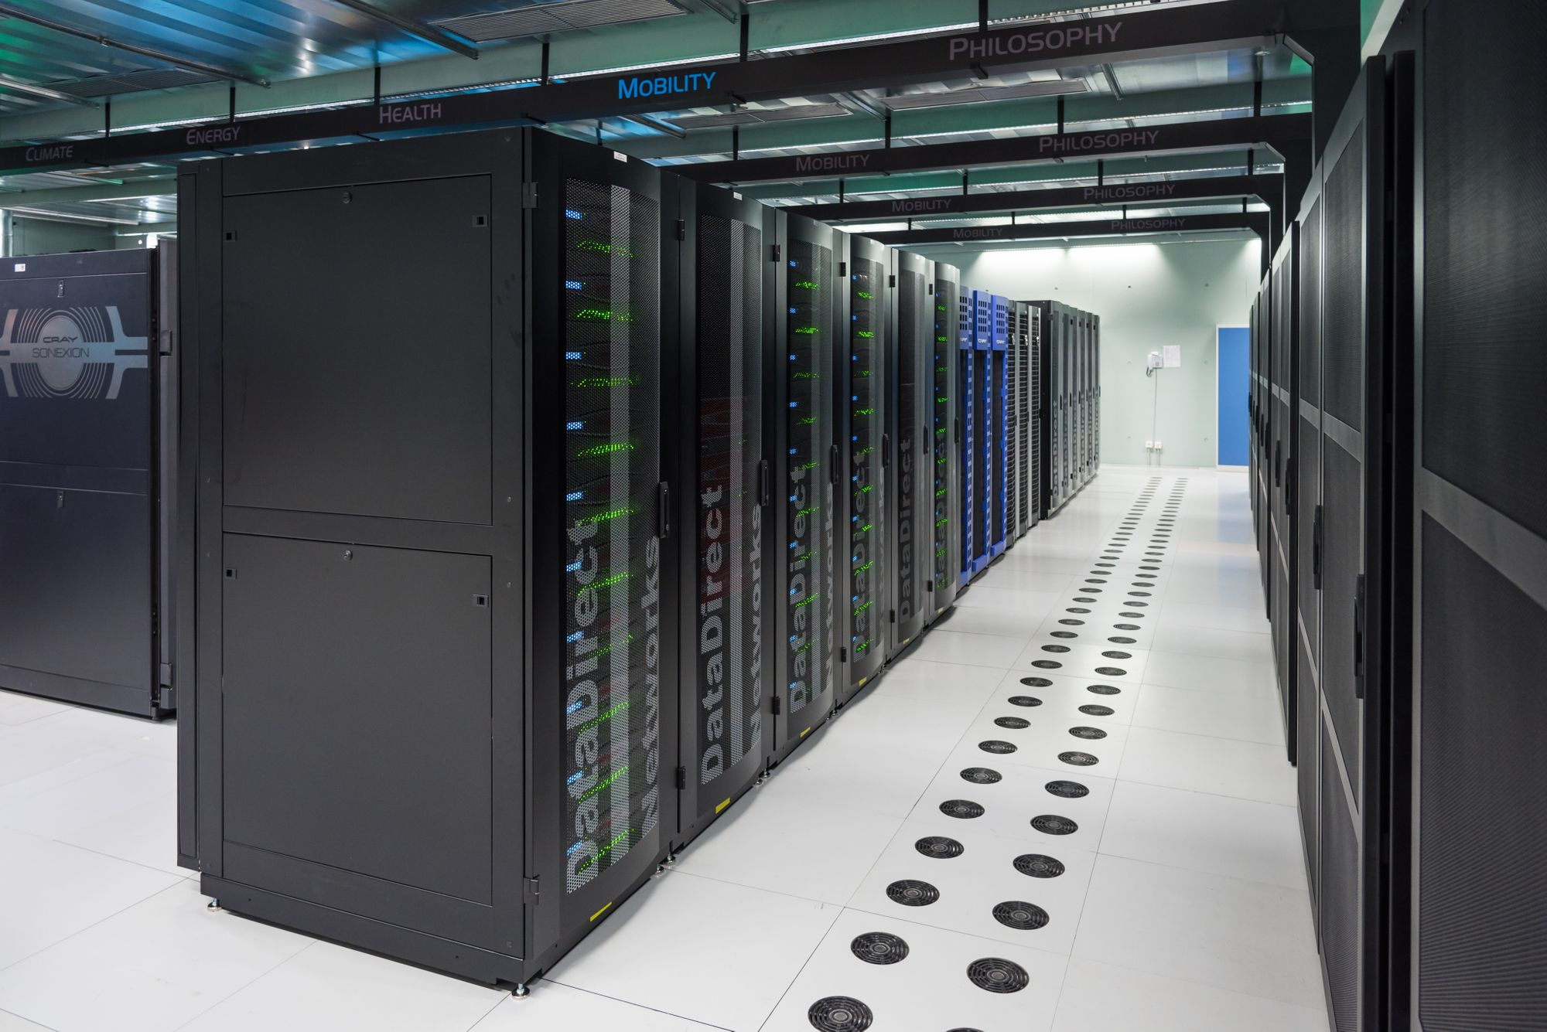
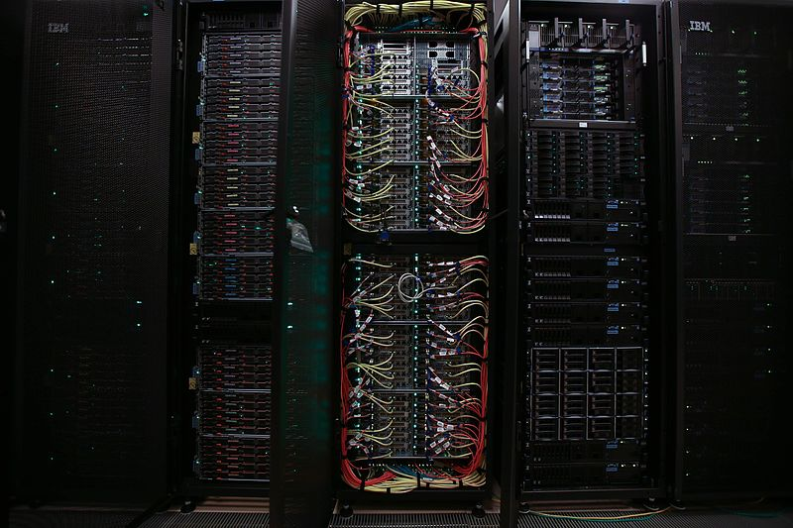
What is BMRC?
Computer cluster
Compute nodes in a rack
https://www.juliosblog.com/high-performance-computing-hpc-on-openstack-a-few-recommendations/
https://commons.wikimedia.org/wiki/File:Pico_supercomputer_rack.jpg

Slide 5
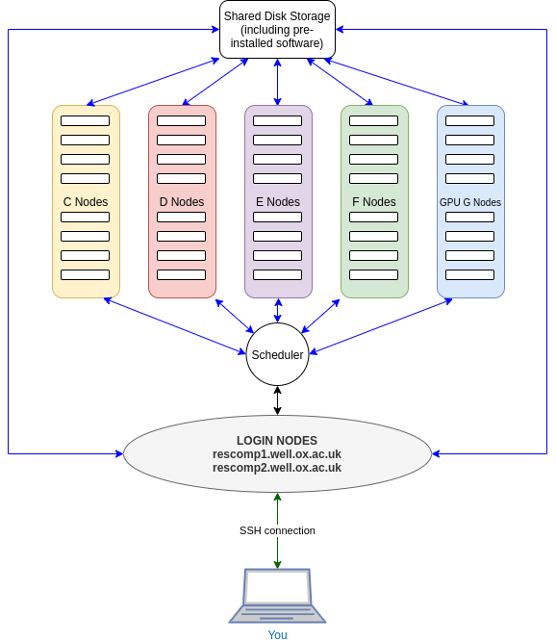
How does BMRC work?
The scheduling software used by BMRC is called Slurm
Compute nodes individually are not much faster than your laptop
Advantage of cluster computing is parallelisation
https://www.medsci.ox.ac.uk/images/support-services-1/biomedical-research-computing/cluster-schematic.png

Slide 6
A little bit of bash
List directory contents
ll
Make a directory
mkdir new_folder
Print working directory
pwd
Change directory
cd new_folder
Move up a directory
cd ..
view the contents of a text file
less file_name
remove a file
rm file_name
remove a directory
rm –r new_folder

Slide 7
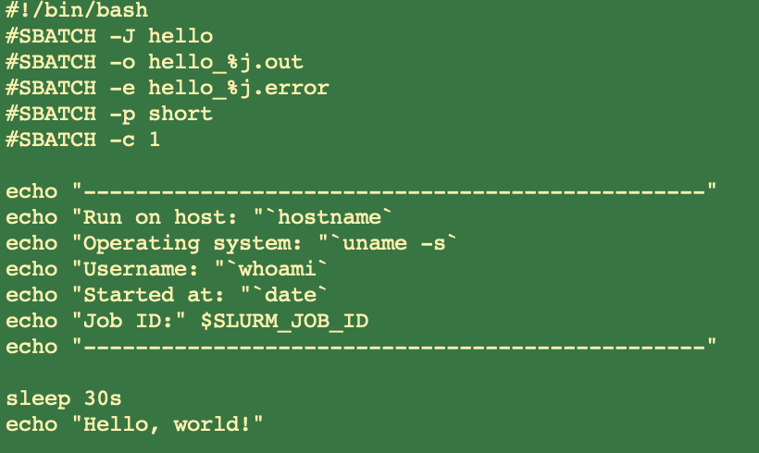
How do I run a job?
Example of a batch script
Filename ‘example.sh’
Run on cluster using: sbatch example.sh
Which queue to send job to?
Partition | Time limit | Default mem per CPU
short | 30 hours | 15.2 GB
long | 10 days | 15.2 GB
relion | 10 days | 15.2 GB
epyc | 10 days | 15.2 GB
fraser | 10 days | 15.2 GB
brcgel | 10 days | 7.5 GB
win | 10 days | 26.2 GB

Slide 8
Your turn…
Copy my script
wget bit.ly/3XI5K3G
rename
mv 3XI5K3G start.sh
Have a look at it
less start.sh
Run it
sbatch start.sh
Look at it go
squeue --me
Check the output
less hello_XXXXXXX.out

Slide 9

Approaches to job management
20 samples to map
A script for each sample
A massive loop over the 20 samples
Workflow management systems

Slide 10
Many scripts
Pros
Cons
Customisation per sample
Error Isolation
Parallel Processing
Easy Debugging
Flexibility for job management
Management Overhead
Consistency
Resource Allocation
Repetitive Work
Complex Workflow

Slide 11
Giant loop
Pros
Cons
Uniformity
Simplicity
Error Propagation
Single Point of Failure
Resource Utilization

Slide 12



Workflow management systems
Pros
Cons
Reproducibility
Scalability
Parallelisation
Dependency Management
Flexibility
Learning Curve
Setup Overhead
Complexity
Debugging

Slide 13

GNU Screen multiplexer
Create a new screen
screen -S name
Leave the screen
ctrl(cmd)+ a d
Resume the screen
screen -r name
End the screen
ctrl(cmd)+d

Slide 14
Available software on BMRC
Find a module:
module avail Anaconda
Load a module
module load Anaconda3/2024.02-1

Slide 15
Your Turn
Retrieve the workflow scripts
wget https://datashare.molbiol.ox.ac.uk/public/project/milne_group/cchahrou/GMS/snakemake.zip
Unzip them:
unzip snakemake.zip
Change directory
cd snakemake
Create and activate the conda environment
conda env create -f conda_env/gms_cluster.yml
Run the workflow in a screen
screen –S cluster
source activate gms_cluster
snakemake -s Snakefile --cores 1 --profile profile/slurm --slurm -j 2

Slide 16
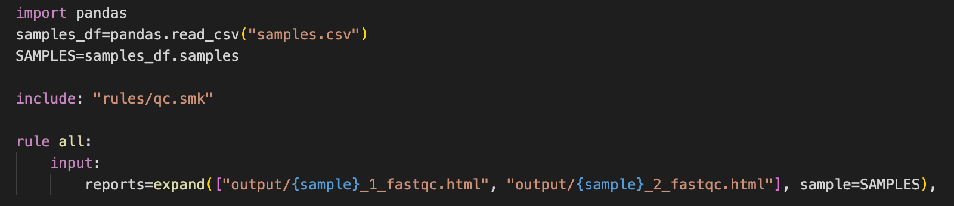
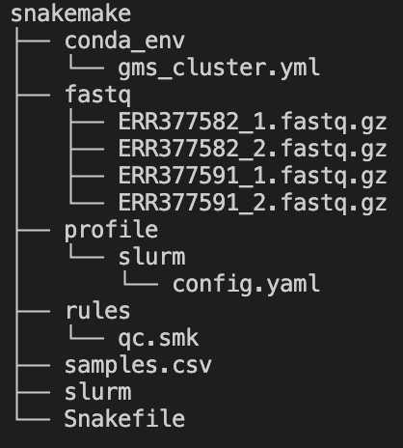
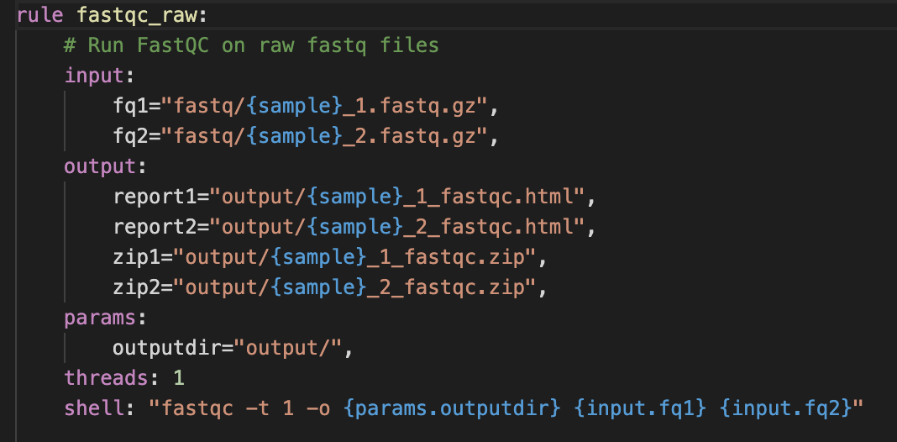
Snakemake

Slide 17
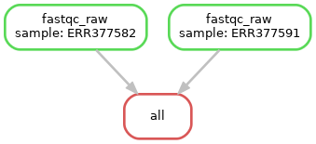
Snakemake output
output/
Logs = .snakemake/logs

Slide 18

Snakemake all the things
https://snakemake.readthedocs.io/

Slide 19
/$$ | $$ /$$$$$$$ /$$$$$$ /$$$$$$ /$$$$$$$ /$$$$$$ /$$$$$$$ /$$$$$$ /$$_____/ /$$__ $$ /$$__ $$| $$__ $$ |____ $$ /$$__ $$ /$$__ $$ | $$$$$$ | $$$$$$$$| $$ \ $$| $$ \ $$ /$$$$$$$| $$ | $$| $$ \ $$ \____ $$| $$_____/| $$ | $$| $$ | $$ /$$__ $$| $$ | $$| $$ | $$ /$$$$$$$/| $$$$$$$| $$$$$$$| $$ | $$| $$$$$$$| $$$$$$$| $$$$$$/ |_______/ \_______/ \____ $$|__/ |__/ \_______/ \_______/ \______/ | $$ | $$ |__/ ./@@/ &@@. .@@@ %@@, #@@* /@@ @@& .@@@ ,@@@ &@@ /@@ .@@@ %@@&#@& *@. @/ .@@%@@@. .@@@@@,@@ &@@@@@@@/ ,@@@@@@@@// @@/#@@@@@@%//#&@@@@@@&, #@@/ %@@@./&@%/,.,/#&@@@@@&, / @@//@@@@&/. .#@@@% @@@@/ ./&@@@@@@#, / &@@@@@@@&%&@@@@@ #@@% &# *@@@@@@@, @@@@@@@@ .@@@&%#/ .* ./. /@@% %
Alastair Smith and Catherine Chahrour

Slide 20
SeqNado
Pipeline based on snakemake to process (so far…):
ChIP-seq,
ATAC-seq,
RNA-seq
SNP calling - short read WGS data
Based on the snakemake¹ workflow management system - reproducible and scalable
Uses singularity container – simple, portable and reproducible
Runs analysis in parallel for each sample
Extendable
Still in development and needs testing
1. Mölder, F., et al, 2021. Sustainable data analysis with Snakemake. F1000Res 10, 33.

Slide 21
What does SeqNado do?
 | ChIP | ATAC | RNA | SNP calling
Pre-processing | Trims, QCs fastq files | Trims, QCs fastq files | Trims, QCs fastq files | Trims, QCs fastq files
Mapping | Bowtie2, removes blacklisted regions | Bowtie2, removes blacklisted regions, Shifts reads for tn5 insertion | STAR, removes blacklisted regions | Bowtie2, removes blacklisted regions
Quantification |  |  | STAR, feature_counts
Peak calling | Macs2, lanceotron, homer | Macs2, lanceotron, homer
Pile up | deeptools, | deeptools | deeptools | deeptools
UCSC hub | Generates UCSC hub | Generates UCSC hub | Generates UCSC hub | no
Analysis | Deeptools heatmap | Deeptools heatmap | DESeq2 | In development

Slide 22
Steps to using SeqNado
Installation
Configuration
Design
Run
Get output

Slide 23

Installation
1. Create a conda/mamba environment and install ‘pip’:
conda create -n seqnado pip
2. Activate the environment:
conda activate seqnado
3. Install SeqNado:
pip install seqnado

Slide 24

Configuration
Creates Project directory containing config.yaml file
seqnado-config rna # or atac/chip/snp
Move to the newly created directory:
cd 2023-04-04-example_project/
Info to have at hand:
chromosome_sizes [path/to/hg38.chrom.sizes]:
indicies [/databank/igenomes/Homo_sapiens/UCSC/hg38/Sequence/Bowtie2Index/genome]:
gtf [/databank/igenomes/Homo_sapiens/UCSC/hg38/Annotation/Genes/genes.gtf]:
blacklist [path/to/hg38-blacklist.v2.bed.gz]:
UCSC_hub_directory [path/to/ publically accessible location on the server]:

Slide 25
Link or move fastq files
ChIP-seq
* samplename1_Antibody_R1.fastq.gz
* samplename1_Antibody_R2.fastq.gz
* samplename1_Input_1.fastq
* samplename1_Input_2.fastq
For ATAC-seq:
* sample-name-1_R1.fastq.gz
* sample-name-1_R2.fastq.gz
* sample-name-1_1.fastq
* sample-name-1_2.fastq
For RNA-seq:
* sample-name-1_R1.fastq.gz
* sample-name-1_R2.fastq.gz
* sample-name-1_1.fastq
* sample-name-1_2.fastq
Move fastq files into fastq/
Symbolic links with full path including /ceph
Concatenate lanes
Careful file-naming

Slide 26

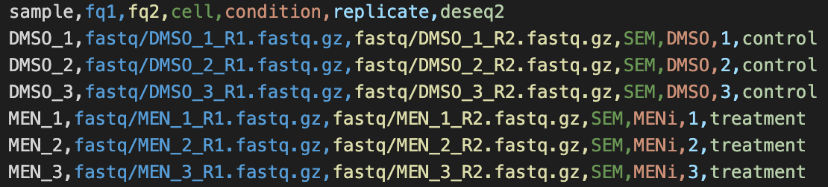
Design
Creates design.csv file based on contents of fastq folder
seqnado-design rna fastq/* # or atac/chip/snp
Edit design.csv for RNA to add the columns: cell, treatment, replicate, deseq2 (must contain “control”)

Slide 27

Run SeqNado
seqnado [atac|chip|rna|snp] –c[INT] [PIPELINE_OPTIONS]...
seqnado rna -c4 --preset ss
Required Number of cores to use: -c, --cores 4
Options:
--preset [lc|ls|ss]
Pre-set snakemake job profile to use for pipeline run:
lc: local conda environment
ls: local singularity environment
ss: slurm singularity environment (runs jobs on cluster)
--dag | dot -Tpng > dag.png
makes a graph of the pipeline:

Slide 28

Get output
Seqnado output files:
Seqnado_output
RNA-seq – deseq2 analysis
DESeq2_example_project.html
UCSC hub
Will be at the path in your config_rna.yaml:

Slide 29

VS Code and an easier life

Slide 30


VS Code
Download and install
https://code.visualstudio.com/download
Install the extension Remote – SSH (secure shell)
Log into BMRC using your credentials

Slide 31
You’re welcome…

